Slide 1
Modelling Health Diagnoses 2
By Ishan Sharma

Slide 2
Overview
Cancer is a complicated issue which affects millions of people
It is very hard to predict it
By creating a model considering geography and other indices, I may be able to predict it

Slide 3
Data processing
From the Institute for Health Metrics and Evaluation
Centerpiece is cancer mortality rate by county, divided into several spreadsheets by state and sheets within it by type of cancer
37 types of cancer
With mortality rate by year from 1980-2014 for each
Additionally contains margin of error between mortality rates
More data but this but this is the main one

Slide 4
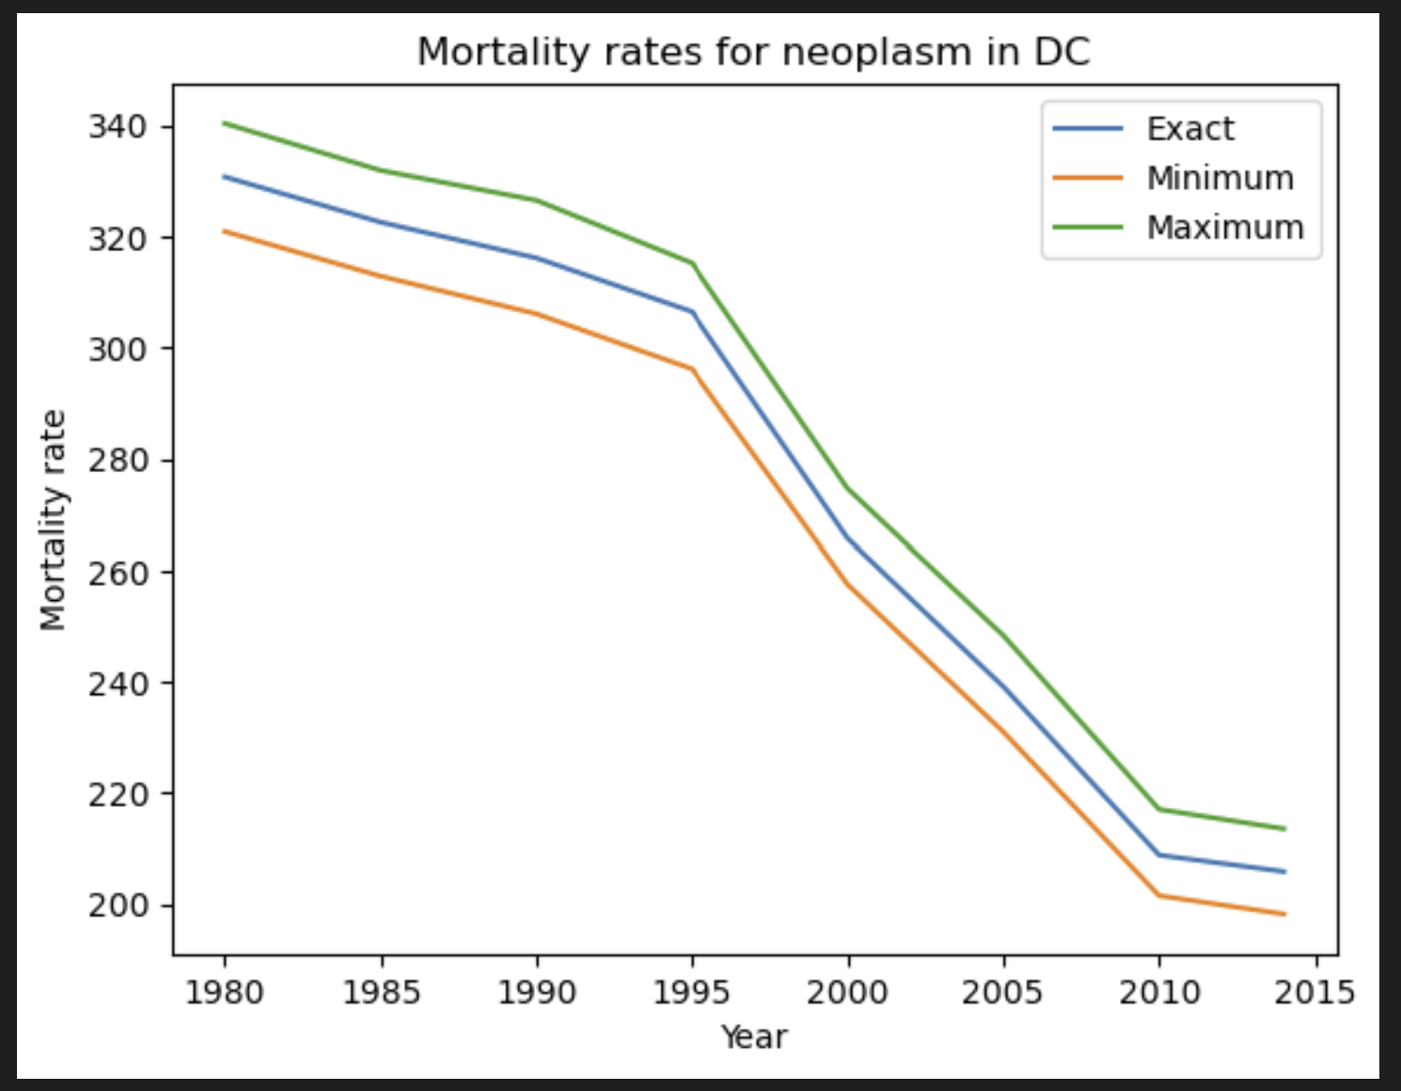
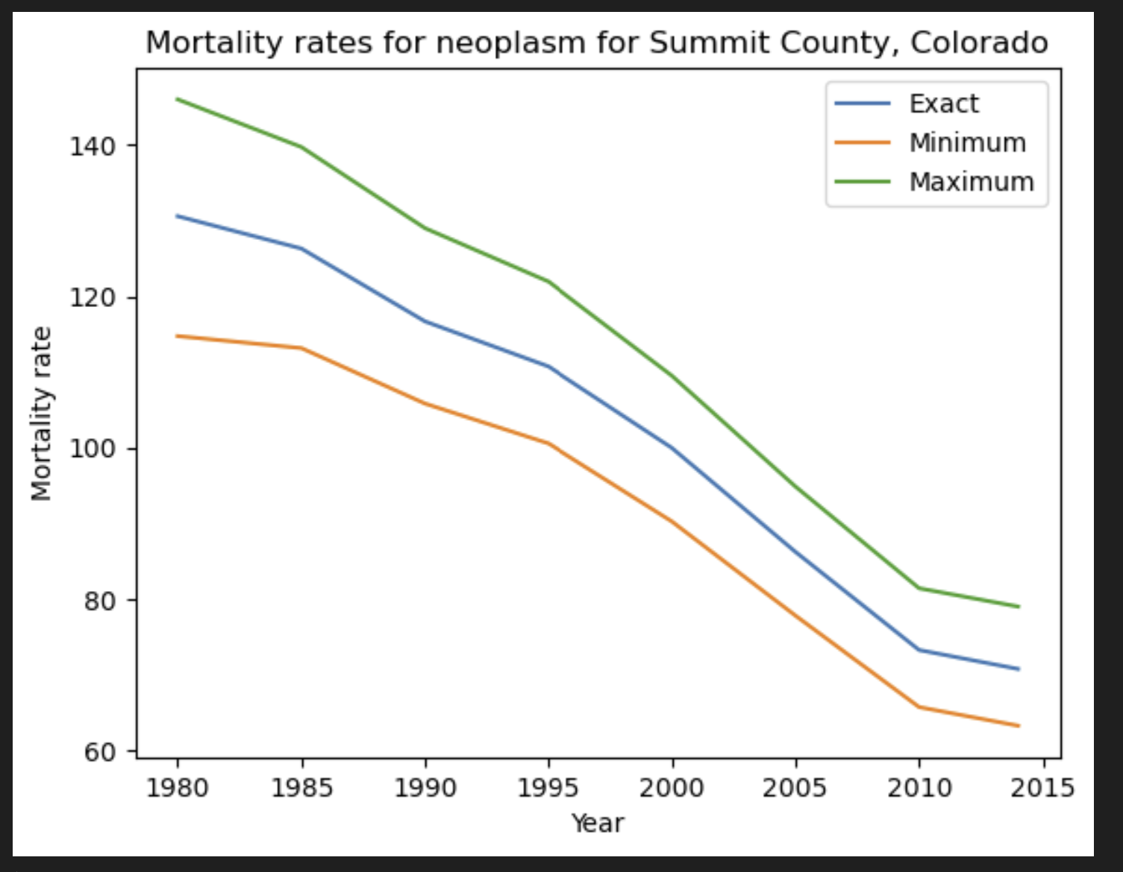
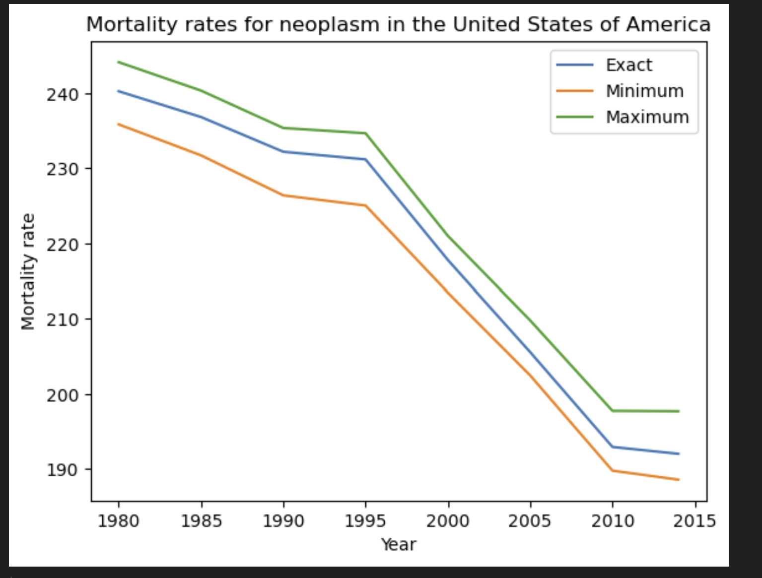
EDA
Exhaustive process
Investigated all 37 different types of cancer in national spreadsheet
In them investigated general US trends, and states and counties with minimal and maximal mortality rates
Findings:
Summit County, Colorado consistently appears as a county with the lowest mortality rate
Oglala Lakota County, South Dakota consistently appears as a county with the highest mortality rate
Utah consistently appears as a state with the lowest mortality rate
The District of Columbia consistently appears as a state with the highest mortality rate, some improvement in more recent years notwithstanding
Error bars vary dramatically

Slide 5
Baseline models
Baseline model is linear regression predicting latter years from former years
Built 37 of them for each different cancer
Scored quite well, from 87% to 98%
Could theoretically combine them together to create one big model by turning each cancer into indicator variables
A pretty good baseline for this metric

Slide 6
Next steps
Build other models:
For specifically the United States
For the whole dataset, w/o differences in types of cancer
Engage in geographic clustering
Peer into other datasets that I have for findings to correlate with my findings.

